Slide 2
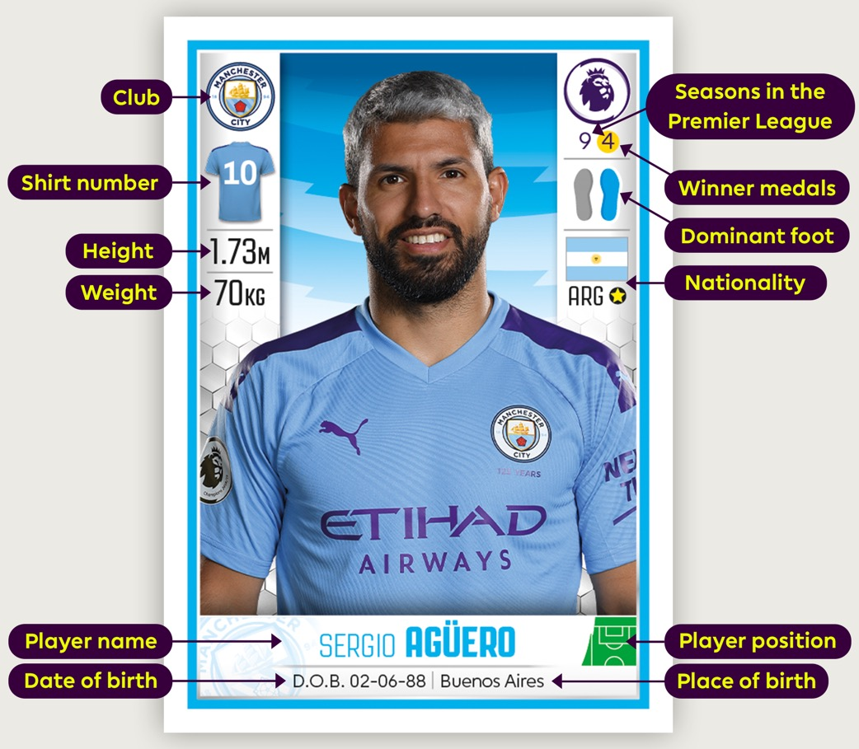
Sticker stats
Use these player stats to solve the following football puzzles.
Notes:
Use the labelled profile to ensure all pupils understand the data fields presented.

Slide 3
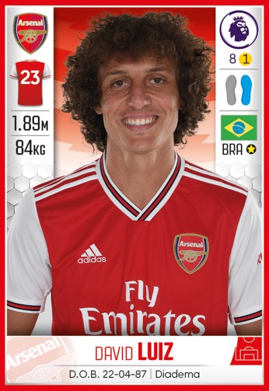
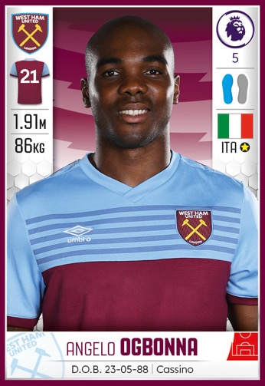
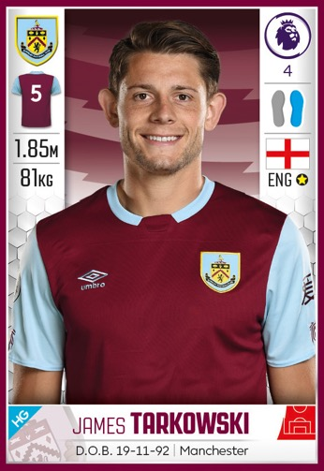

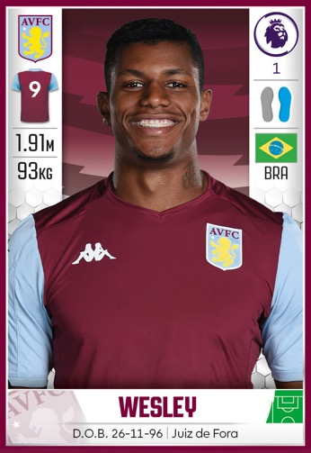
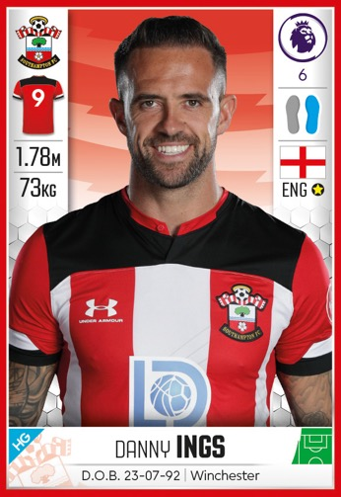
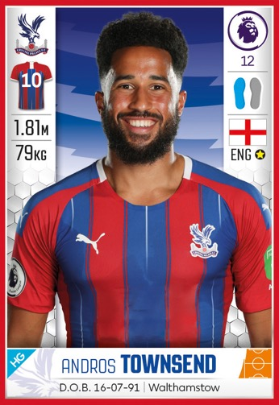
Logical positions
Six players are lined up in the
tunnel before a game like this:
As the Match Day
Commentator, use the clues
on the following slide to
identify the order the players
will walk out of the tunnel for
your announcement.
Notes:
Logical positions (1 slide of 2)
This activity is best manipulated or drawn. You could either print and cut out the profiles OR write each player’s fact down, cut out and move around.

Slide 4
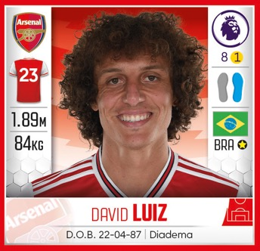
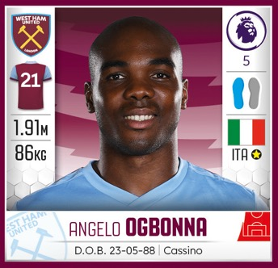
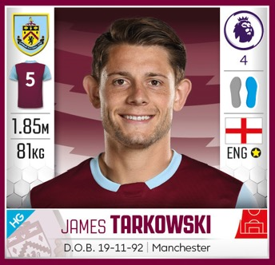
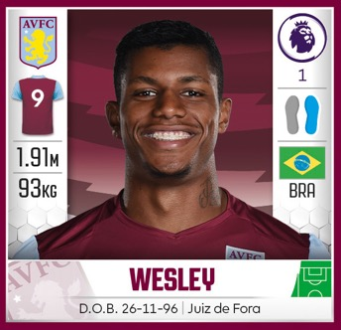
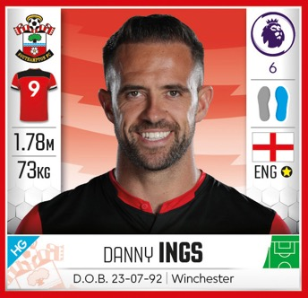
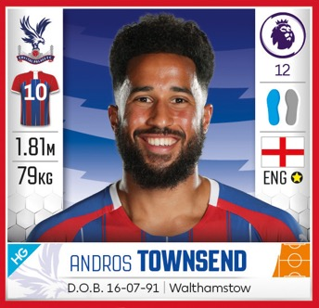
Logical positions
The player weighing more than 90kg
is not next to a Crystal Palace player.
The player who is older than 32 is between a player who does not play for Aston Villa and the player who is taller than 1.90m.
The sixth player is not
a defender or a forward.
The player who is older than
32 is next to the player with
a ‘square number’ on his shirt.
Notes:
Logical positions ANSWERS (slide 2 of 2)
ANSWER (a couple of the possible solutions)
1. OGBONNA 4. WESLEY
2. LUIZ 5. INGS
3. TARKOWSKI 6. TOWNSEND
WESLEY 4. OGBONNA
INGS 5. LUIZ
TARKOWSKI 6. TOWNSEND

Slide 5
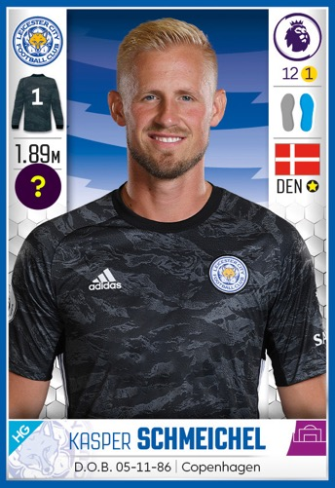
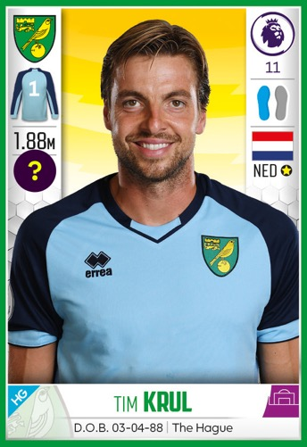
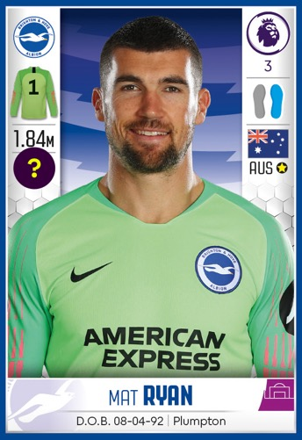
Car share
You are a Player Liaison Officer and have been asked to drive three goalkeepers to a training session.
Disaster! You have a problem with your car suspension and can only take the two lightest goalies.
Schmeichel and Krul together weigh 173kg.
Krul and Ryan together weigh 166kg.
Ryan and Schmeichel together weigh 171kg.
What is the weight of each player?
Who will be left behind?
Notes:
Car share
Discuss the range the weights are likely to fall within; perhaps calculate the average weight for each pair as a starting point.
ANSWER
Kasper Schmeichel = 89kg; Tim Krul = 84kg and Mat Ryan = 82kg
Kasper Schmeichel would be left.
Hint
They each have a different weight.

Slide 6
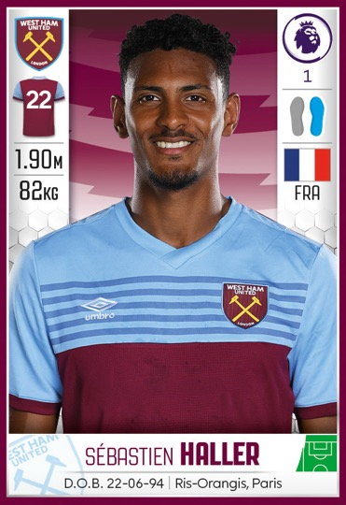
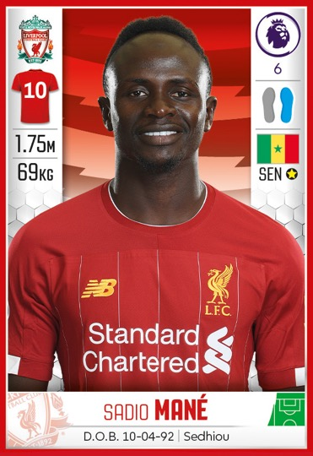
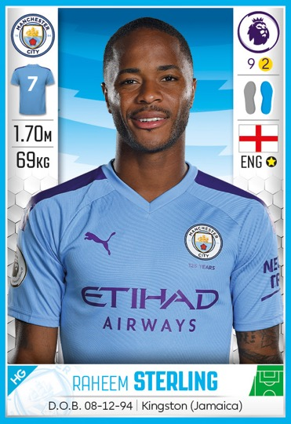
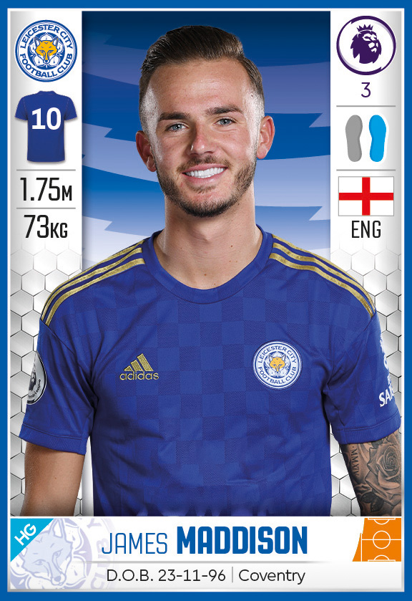
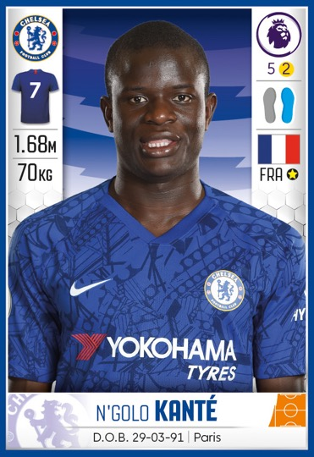
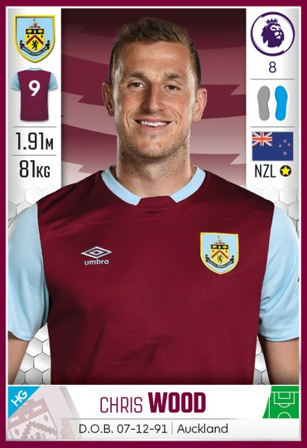
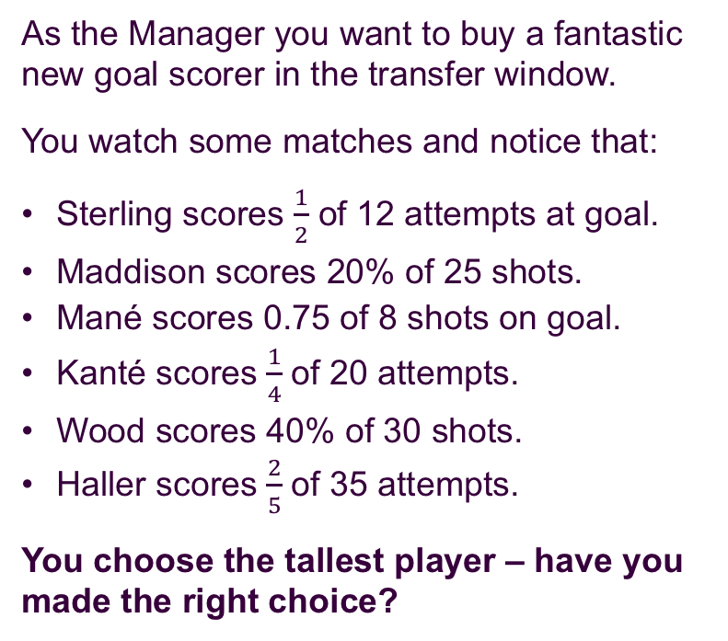
Successful shots
As the Manager you want to buy a fantastic new goal scorer in the transfer window.
You watch some matches and notice that:
Sterling scores $\frac{1}{2}$ of 12 attempts at goal.
Maddison scores 20% of 25 shots.
Mané scores 0.75 of 8 shots on goal.
Kanté scores $\frac{1}{4}$ of 20 attempts.
Wood scores 40% of 30 shots.
Haller scores $\frac{2}{5}$ of 35 attempts.
You choose the tallest player – have you made the right choice?
Notes:
Successful shots
ANSWER
HALLER is the tallest but he only scored 2/5 out of 35 – although this is numerically 14, the highest, it is not the best performance.
MANÉ: 0.75 of 8 shots = 3/4 = 0.75 = 75% (6 successful shots)
STERLING: ½ of 12 shots = 1/2 = 0.5 = 50% (6 successful shots)
WOOD: 40% of 30 shots = 2/5 = 0.4 = 40% (12 successful shots)
HALLER: 2/5 of 35 attempts = 2/5 = 0.4 = 40% (14 successful shots)
KANTÉ: ¼ of 20 shots = 1/4 = 0.25 = 25% (5 successful shots)
MADDISON: 20% of 25 shots = 1/5 = 0.2 = 20% (5 successful shots)

Slide 7
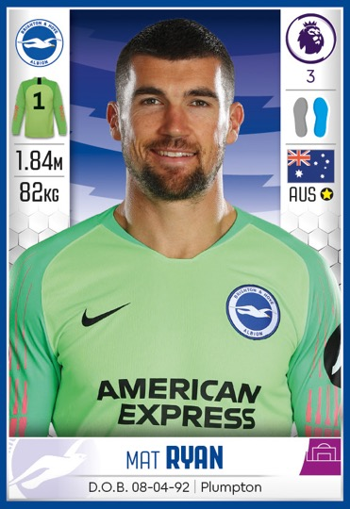
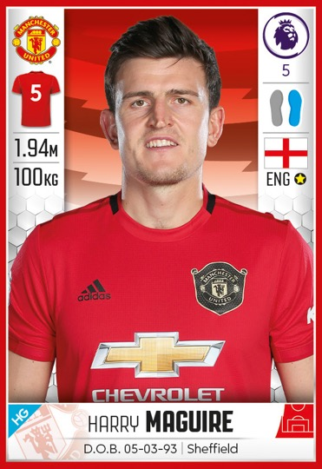
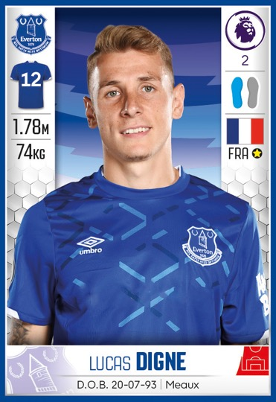
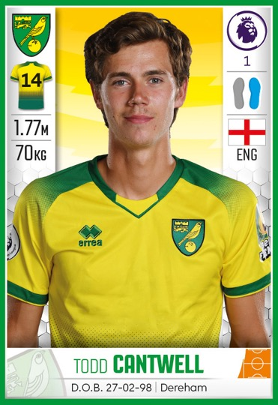
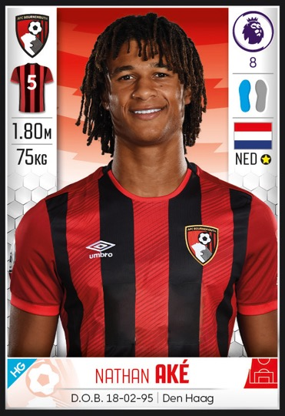
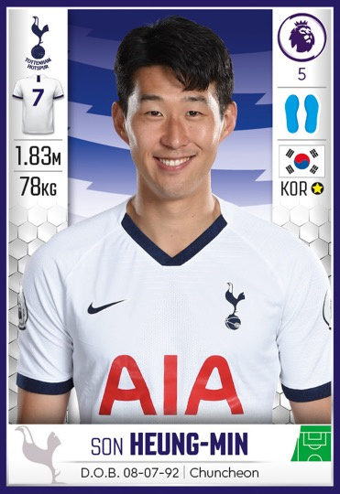
Player mascots
As the Kit Manager, you are organising the kits for the child mascots for these players
at the next match.
Each child mascot is half the height and weight of the player they will walk out with.
Notes:
Player mascots (Slide 1 of 2)

Slide 8
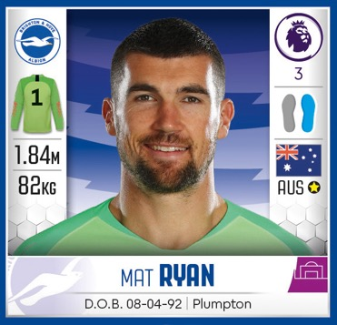
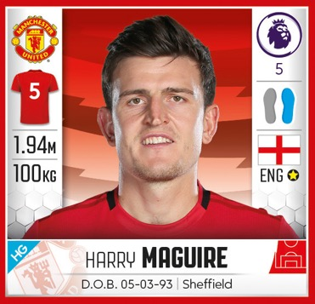
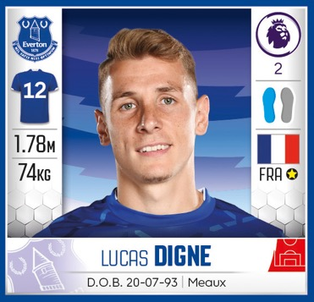
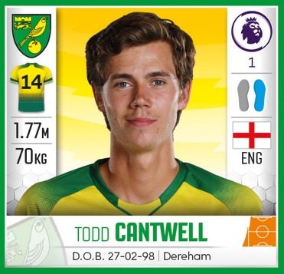
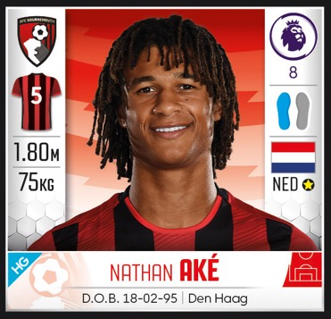
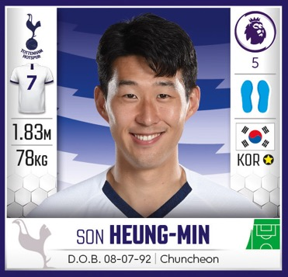
Player mascots
Remember that the mascots are half the height and weight of their player.
This particular mascot kit has been made
for a player mascot who is:
Taller than 90cm.
Weighs less than 40kg.
With a player who is older than 27.
Which player will be able to present
their child mascot with this kit?
Notes:
Player mascots ANSWERS (Slide 2 of 2)
ANSWER
The player mascot would be with Son Heung-Min ½ height = 91.5cm; ½ weight = 39kg; birth date 8/7/92 (player was 27 in 2019)
Hint
Encourage children to convert heights to cm’s.
Ensure children are aware that kits are made to fit all sizes to avoid any sensitivity.

Slide 9

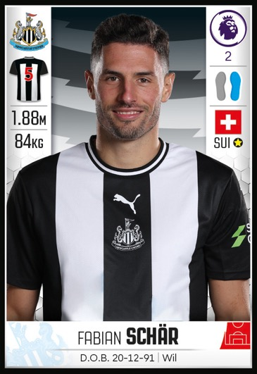
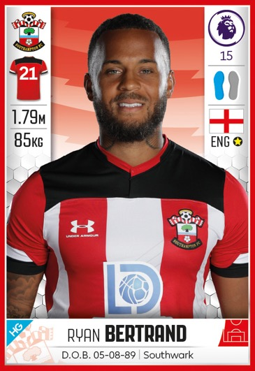

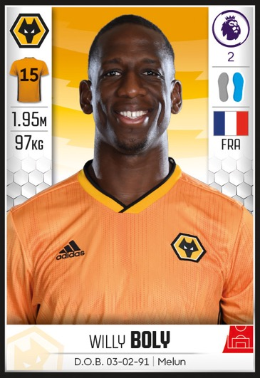
Defensive data
As a Scout you’ve been asked to identify two defenders for a club to approach in the transfer window. They’ve made the assumption that right footed defenders are the best option.
Notes:
Defensive data (Slide 1 of 2)
Puzzle submitted by Bobby Seagull.

Slide 10

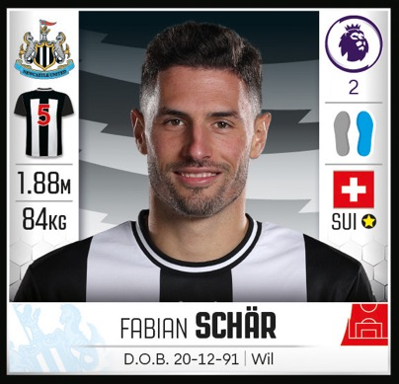
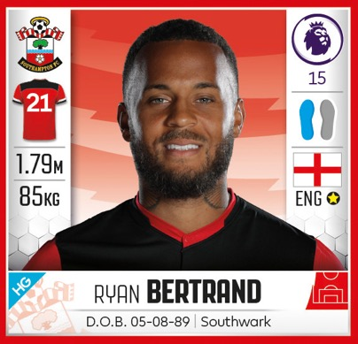

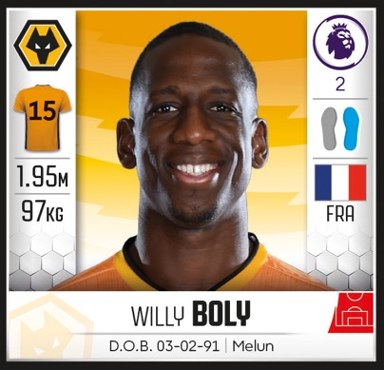
Defensive data
Can you look at the tackle success rates
and put the defenders in order of preference?
Are your best options right footed players?
Tackle success rates:
Aké = 2/3
Schär = 0.59
Betrand = 0.62
Ogbonna = 70%
Boly = 13/20
Notes:
Defensive data (Slide 2 of 2)
ANSWER
1. OGBONNA = 0.7 = 70% (Left footed)
2. AKÉ = 2/3 = 0.666 = 66.6% (Left footed)
Both of the best options are in fact left footed in this example.
3. BOLY = 13/20 = 0.64 = 65% (Right footed)
4. BERTRAND= 0.62 = 62% Left footed)
5. SCHÄR = 0.59 = 59% (Right footed)

Slide 11
Answers
Logical positions
A couple of the possible solutions:
1. OGBONNA 4. WESLEY
2. LUIZ 5. INGS
3. TARKOWSKI 6. TOWNSEND
1. WESLEY 4. OGBONNA
2. INGS 5. LUIZ
3. TARKOWSKI 6. TOWNSEND
Car Share
Kasper Schmeichel = 89kg
Tim Krul = 84kg
Mat Ryan = 82kg
Kasper Schmeichel would be left.
Successful shots
HALLER is the tallest but he only scored
2/5 out of 35 – although this is numerically
14, the highest, it is not the best performance.
MANÉ is the correct answer, with the highest success rate.
MANÉ: 0.75 of 8 shots = 3/4 = 0.75 = 75%
(6 successful shots)
STERLING: ½ of 12 shots = 1/2 = 0.5 = 50%
(6 successful shots)
WOOD: 40% of 30 shots = 2/5 = 0.4 = 40%
(12 successful shots)
HALLER: 2/5 of 35 attempts = 2/5 = 0.4 = 40% (14 successful shots)
KANTÉ: ¼ of 20 shots = 1/4 = 0.25 = 25%
(5 successful shots)
MADDISON: 20% of 25 shots = 1/5 = 0.2 = 20% (5 successful shots)
Player mascot
The player mascot would be with Son Heung-Min
½ height = 91.5cm; ½ weight = 39kg;
birth date 8/7/92 (player was 27 in 2019)
Defensive data
OGBONNA = 0.7 = 70% (Left footed)
AKÉ = 2/3 = 0.666 = 66.6% (Left footed)
Both of the best options are in fact left footed in this example.
BOLY = 13/20 = 0.65 = 65% (Right footed)
BERTRAND = 0.62 = 62% Left footed)
SCHÄR = 0.59 = 59% (Right footed)

