Slide 1
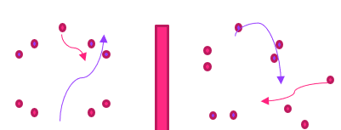
Guardians of the gate| LO: Understand the importance of scanning, reaction times and agility.
PL Value
Be ambitious
Be inspiring
Be connected
Be fair
What does the activity look like?
✓
HOW TO PLAY
Set up and equipment:. Split pupils into two groups. Place the coloured cones (‘gates’) in the space. Each group will have a set of bibs (different colours). This activity can be conducted in a sports hall or outdoor space. A spare set of bibs.
Activity 1: Tag game with a twist – limit contact (throw a bib between the waist and shoulders in order to ‘tag’). Instead of calling out the name of a pupil, the teacher will use description, e.g. ‘Those wearing grey trousers are the taggers’. Rotate every 15 seconds with a 5-second pause in between. Intermittently, call “back to base” where pupils can go back to a space/bubble area. Play for a few minutes and remind pupils of the importance of scanning the space, especially when pausing to make sure it’s safe to come to a stop. Activity 2: Set up the space (see diagram). Split the class into two groups, e.g. purple team versus pink team. Each team will try being the attackers and defenders – rotate regularly. Each team must go through ‘their ’cones (the cones that are their team’s colour). Teams must try to stop the opposing team from going through the cones by tagging. Nominate someone to record the scores. Progression: Try the suggestions to increase difficulty and challenge pupils further:
Different start positions, pupils could start by sitting down.
Include different physical movements. E.g. Once caught, pupils must do a star jump.
Different positioned gates at opposite ends of the space – pupils will have to think about whether it is easy to go for 1 point closer to home or get 5 points by going closer to their opponent’s base.
✓
✓
✓
What skills will pupils develop?
Thinking skills
Concentration Pupils will be focused to improve reaction times and scanning techniques and spaces
Social and emotional skills
Communication Pupils will interact with the rest of the class, offering feedback; peer review and demonstrations
Physical skills
Agility and speed Pupils will exercise a variety of skills: endurance, agility, speed and power

