Slide 1
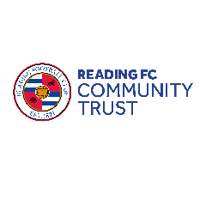
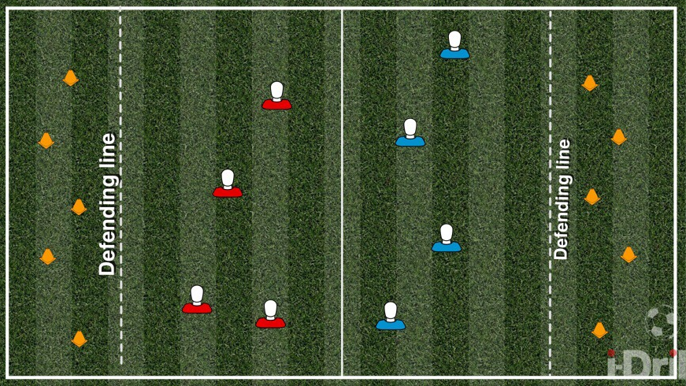
Cone attack | LO: Develop tactics and work collectively as a team in an attack vs defence game.
PL Value
Be ambitious
Be inspiring
Be connected
Be fair
What does the activity look like?
✓
HOW TO PLAY
Set up and equipment: Split the group into two teams. Use the playground court markings or a coned rectangle and create a line of cones across the middle dividing the two teams. They must remain in their half. Place five cones at either end of the half. You will need five balls to play this game and a set of cones. This activity would work best indoors. Activity: The aim of the game is to roll the ball underarm and get it to hit and knock over the opposing team’s line of traffic cones. The first team to knock over all five cones wins. Pupils cannot enter the opponent’s half, neither can they stand and guard the cones. To support safeguarding, encourage pupils to keep the balls low when sending towards the target.
Progression: 1. Pupils can use their feet to pass the ball to get it to hit the traffic cones.
2. Nominate one player in the defensive zone to try and stop them from hitting the cones.
3. Identify one player to retrieve balls for the rest of the team.
✓
✓
What skills will pupils develop?
Thinking skills
Time and space management Pupils will need to anticipate when to roll the ball into space as well as where to stand
Social and emotional skills
Communication Pupils will need to talk to each other to discuss tactics, who is better at rolling the ball, who is better at tracking and stopping the ball
Physical skills
Agility and coordination Pupils will need agility and balance to stop the balls from hitting the cones

