Slide 2
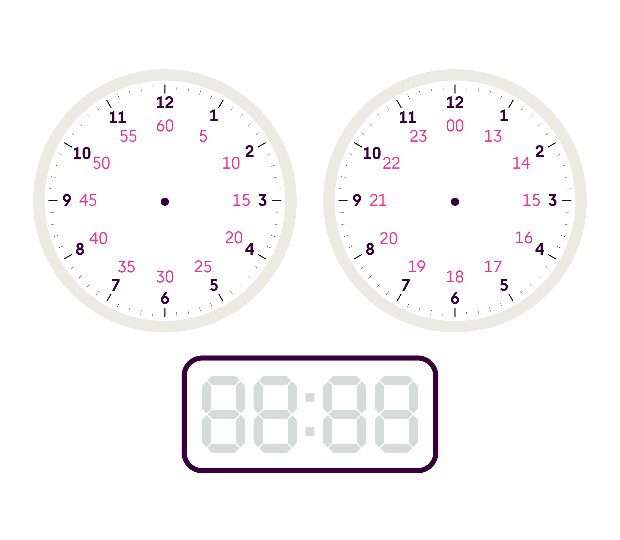
Before you get started
Can you remember how to:
count in 5s? E.g. 5, 10, 15…
read the time on an analogue clock?
read the time on a digital clock?
read the time as a 24 hour clock?

Slide 3
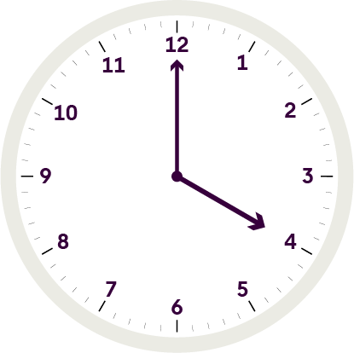
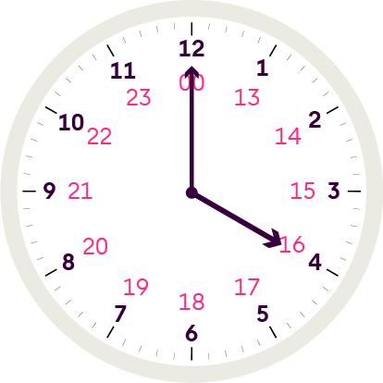
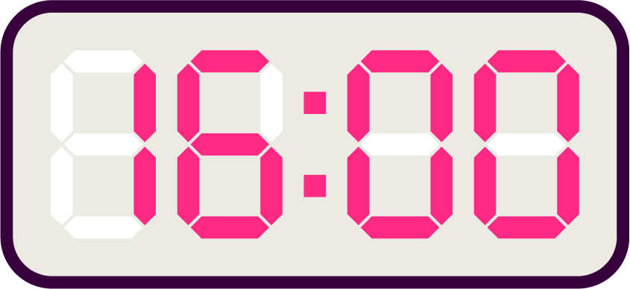
Before you get started
Types of clock
A digital clock
A digital clock or watch
has a number display.
An analogue clock
An analogue clock or watch
has hands to show 12 hour
clock times. We use am for
times before noon (midday)
and pm for times after noon.
A 24-hour clock
For 24-hour clock times, the hours are numbered in a day from 00:00 to 23:59. Times always have four figures. Four o’clock
in the afternoon, or 4:00pm, is
16:00 in the 24-hour clock time.

Slide 4
Before you get started
Can you join up the correct periods of time?
There are:

Slide 5
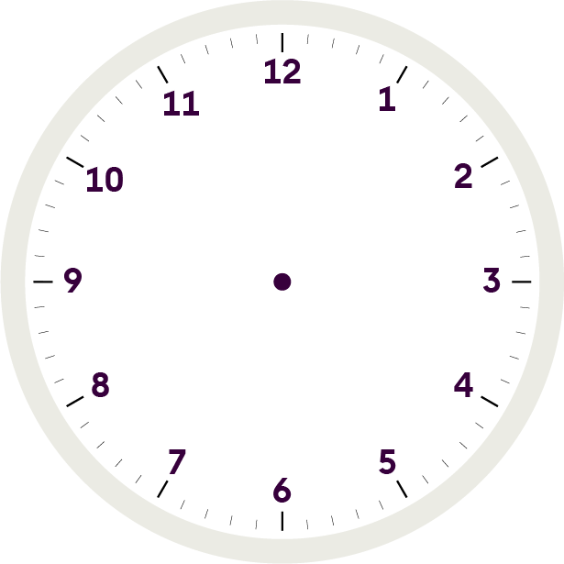
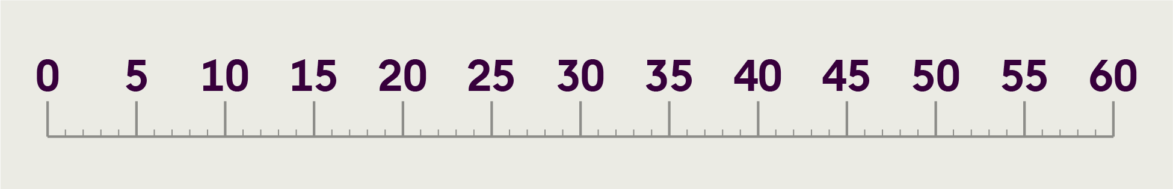
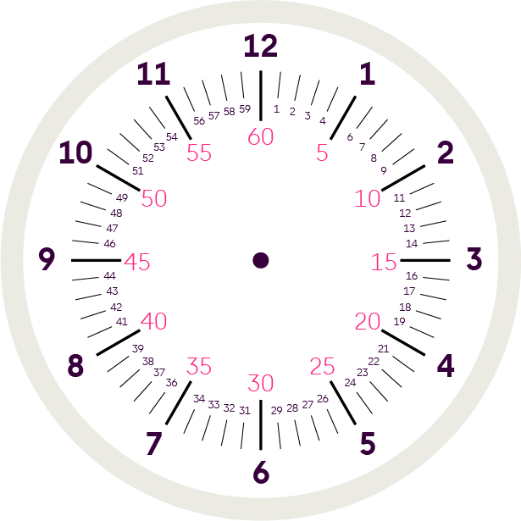
Analogue clock
Here is an
analogue clock:
We can think of this as a straight number line:
And this clock has the minutes
shown in increments
of 5 minutes:
This is useful when we add or subtract minutes and it can help us to solve problems working out time.

Slide 6
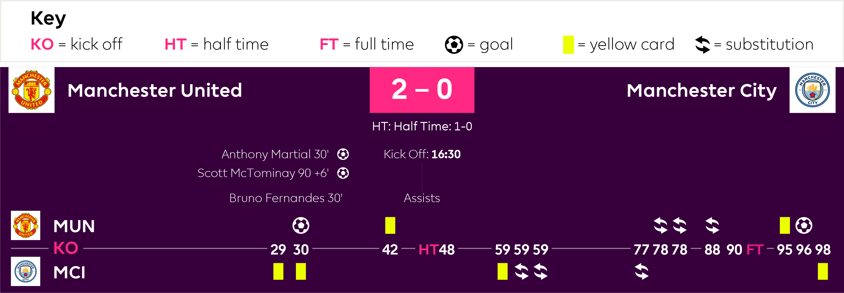
Glossary of football terms
In football we use timelines to highlight when key match events took place.

Slide 8
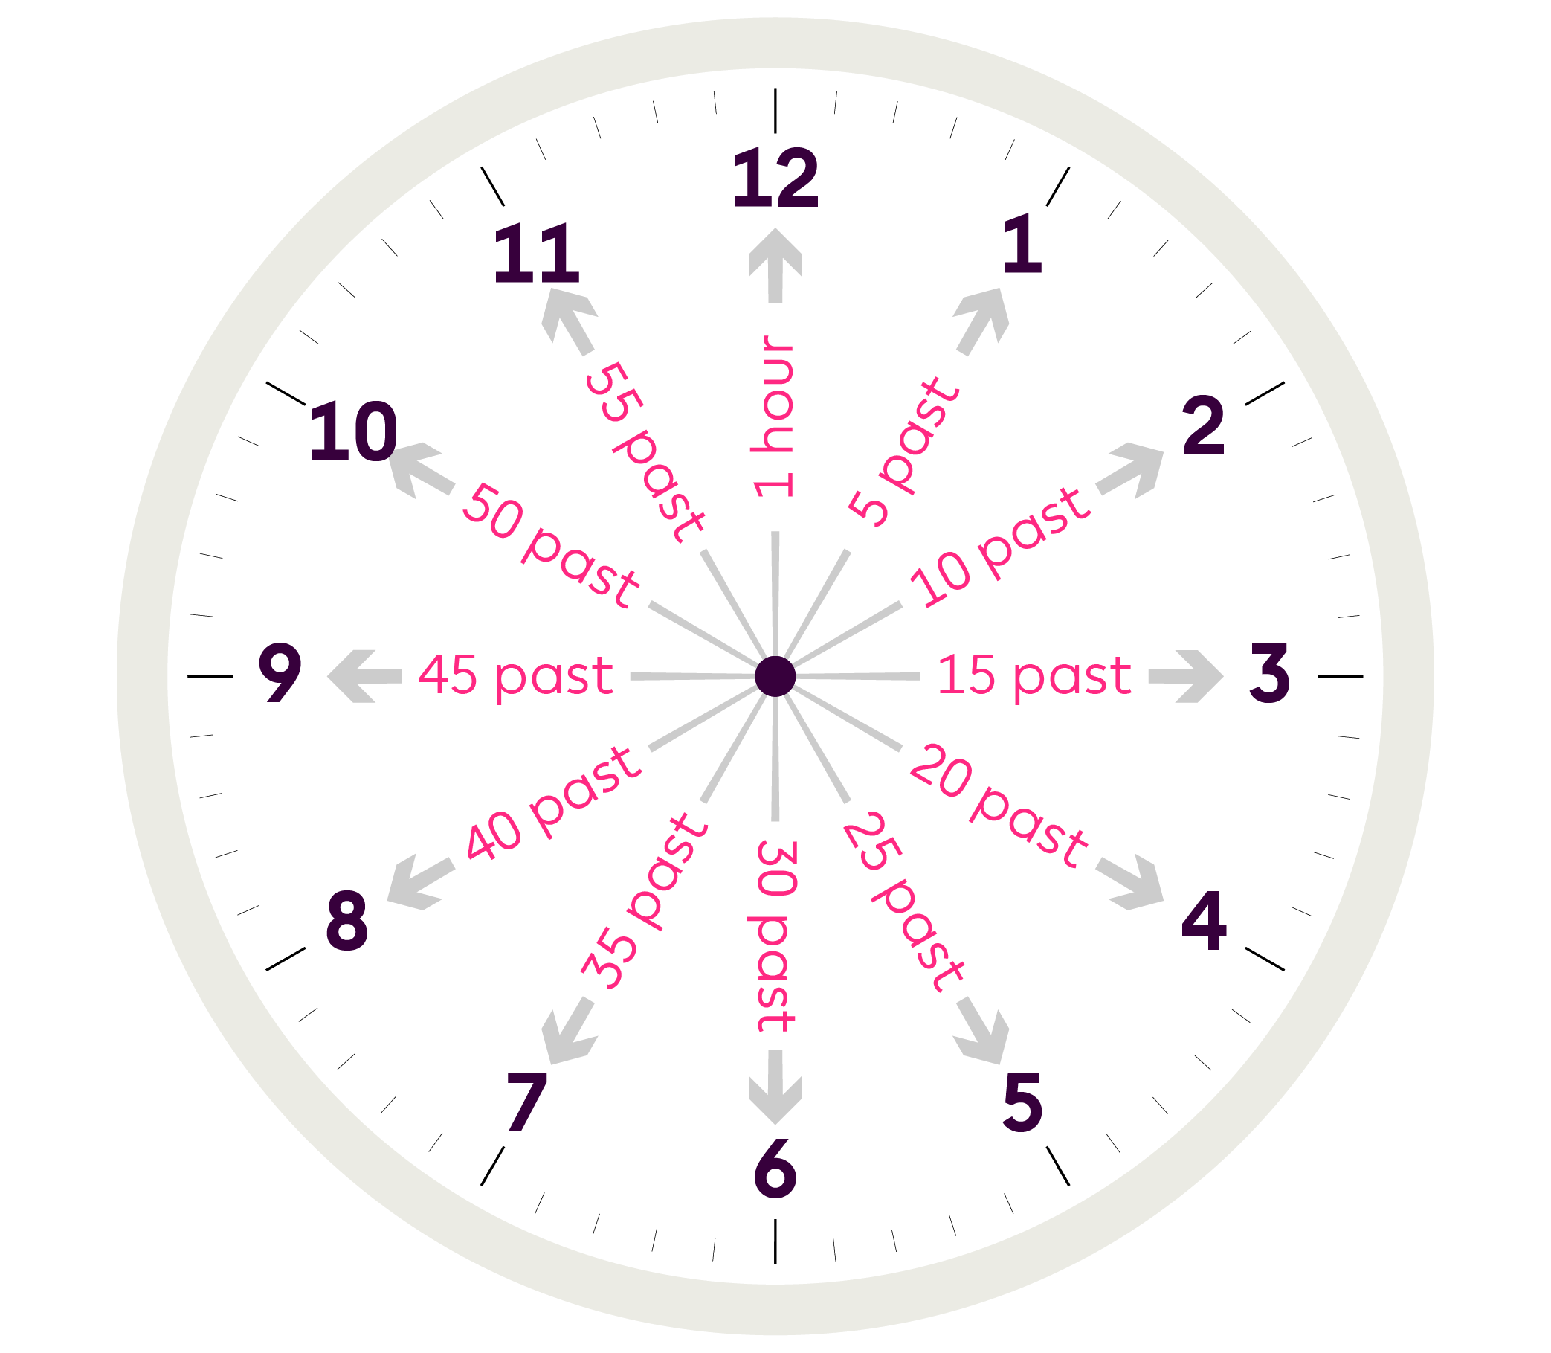
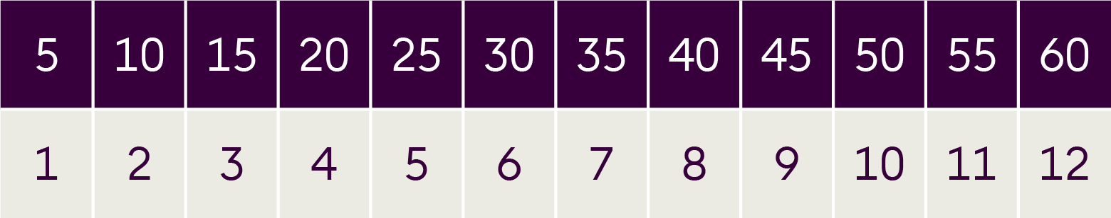
Counting up
When the minute hand points to 4, that means it is 20 minutes past
the hour.
When we reach 60, it is one hour.

Slide 9
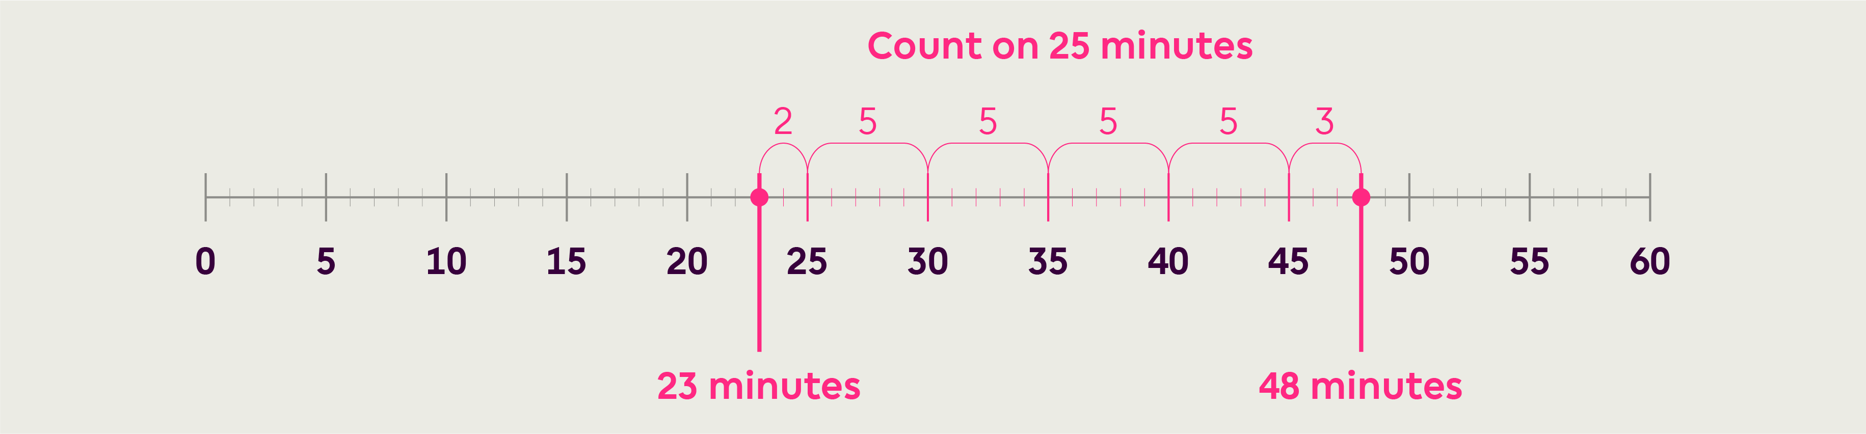
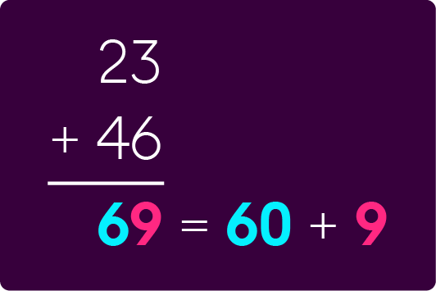
Adding minutes to under 60 minutes
We can use the timeline to help us add minutes.
For example: 23 minutes and 25 minutes would give a total of 48 minutes. We can count on 25 on the number line from 23.

Slide 10
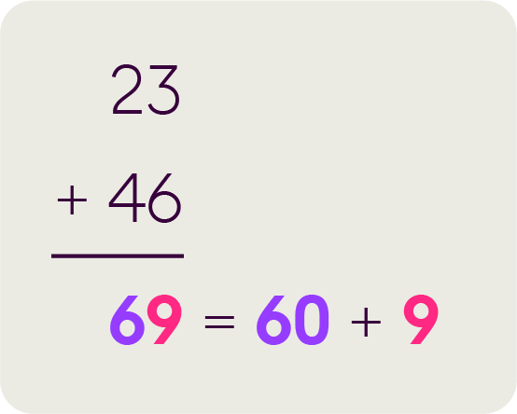
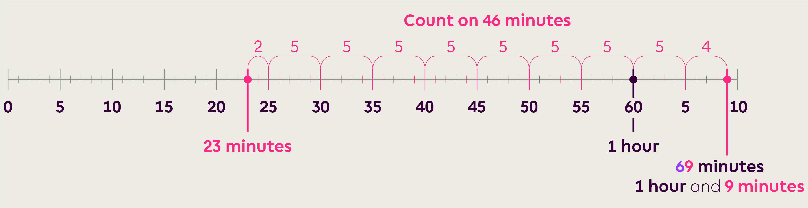
Adding minutes to over 60 minutes
We need to be careful if the total adds up to more than 60:
23 minutes and 46 minutes = 69 minutes.
This is 1 hour (60 minutes) and 9 minutes

Slide 12
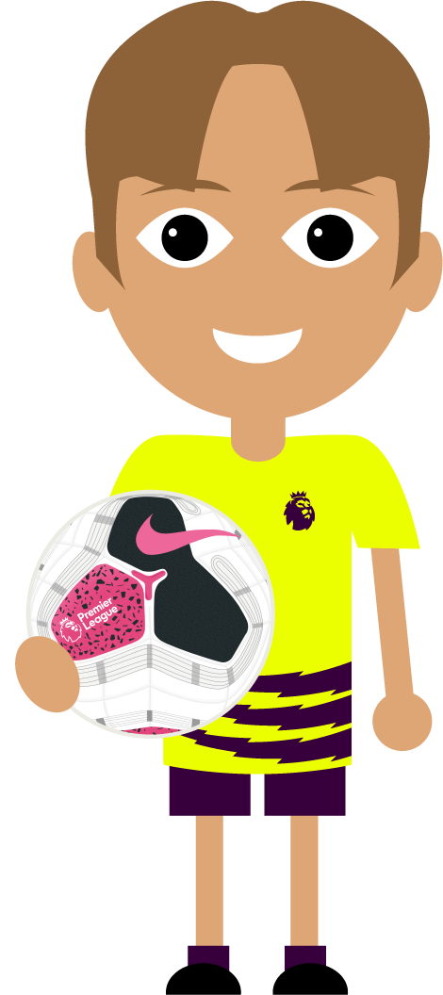
Adding mixed units of time
To add mixed units of times (e.g. hours and minutes) together, it is easiest to first convert them all to the same.
For example:
A player played in one match for
38 minutes, in a second match
for 1 hr 15 mins and in a third
match for 1 hr 30 mins.
What is the total time he played?
To work out the total, we need to convert the hours and minutes to minutes.
Step 1: convert the hours and minutes to minutes.
1 hr = 60 minutes so:
1 hr 15 mins is 60 +15 = 75 mins
1 hr 30 mins is 60 + 30 = 90 mins
Step 2: add the minutes together.
38 + 75 + 90 = 203 minutes

Slide 13
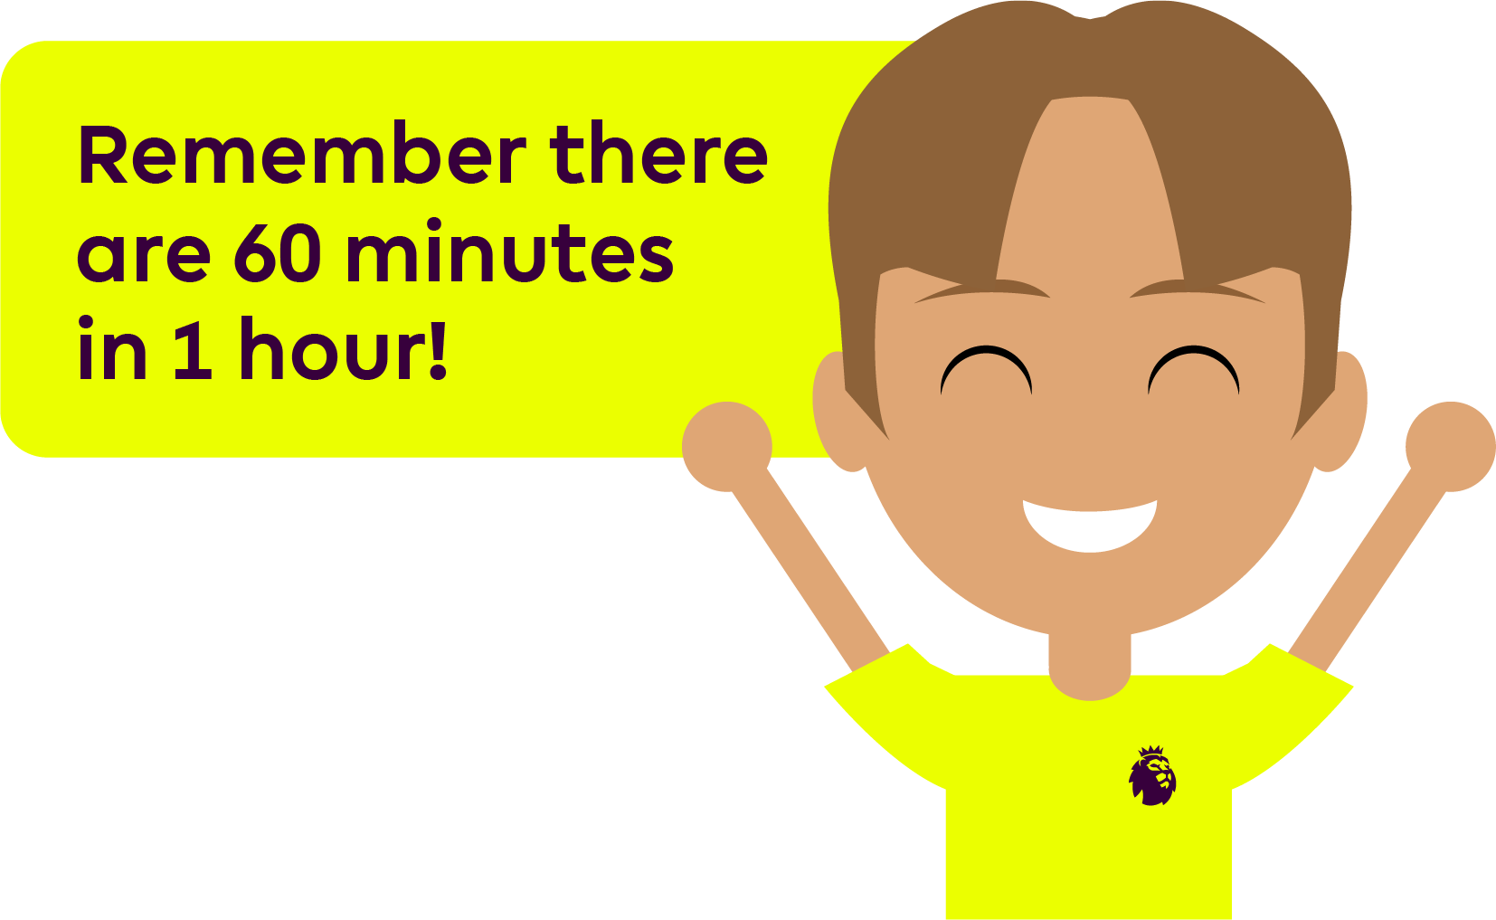
Adding mixed units of time
So now we can add 38, 75 and 90 mins which gives us a total of 203 mins.
How many groups of 60 are in 203?
60+60+60 = 180 mins so that is 3 hrs.
Count up from 180 to 203 and we have another 23 mins
So the total time played is
3 hours and 23 minutes

Slide 14
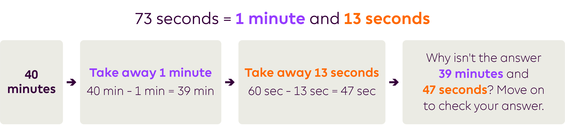
Subtracting mixed units of time
Remember to do the same for subtraction
For example:
A team took two corners 73 seconds apart - if the second one was taken on 40 minutes, when was the first one taken?

Slide 15
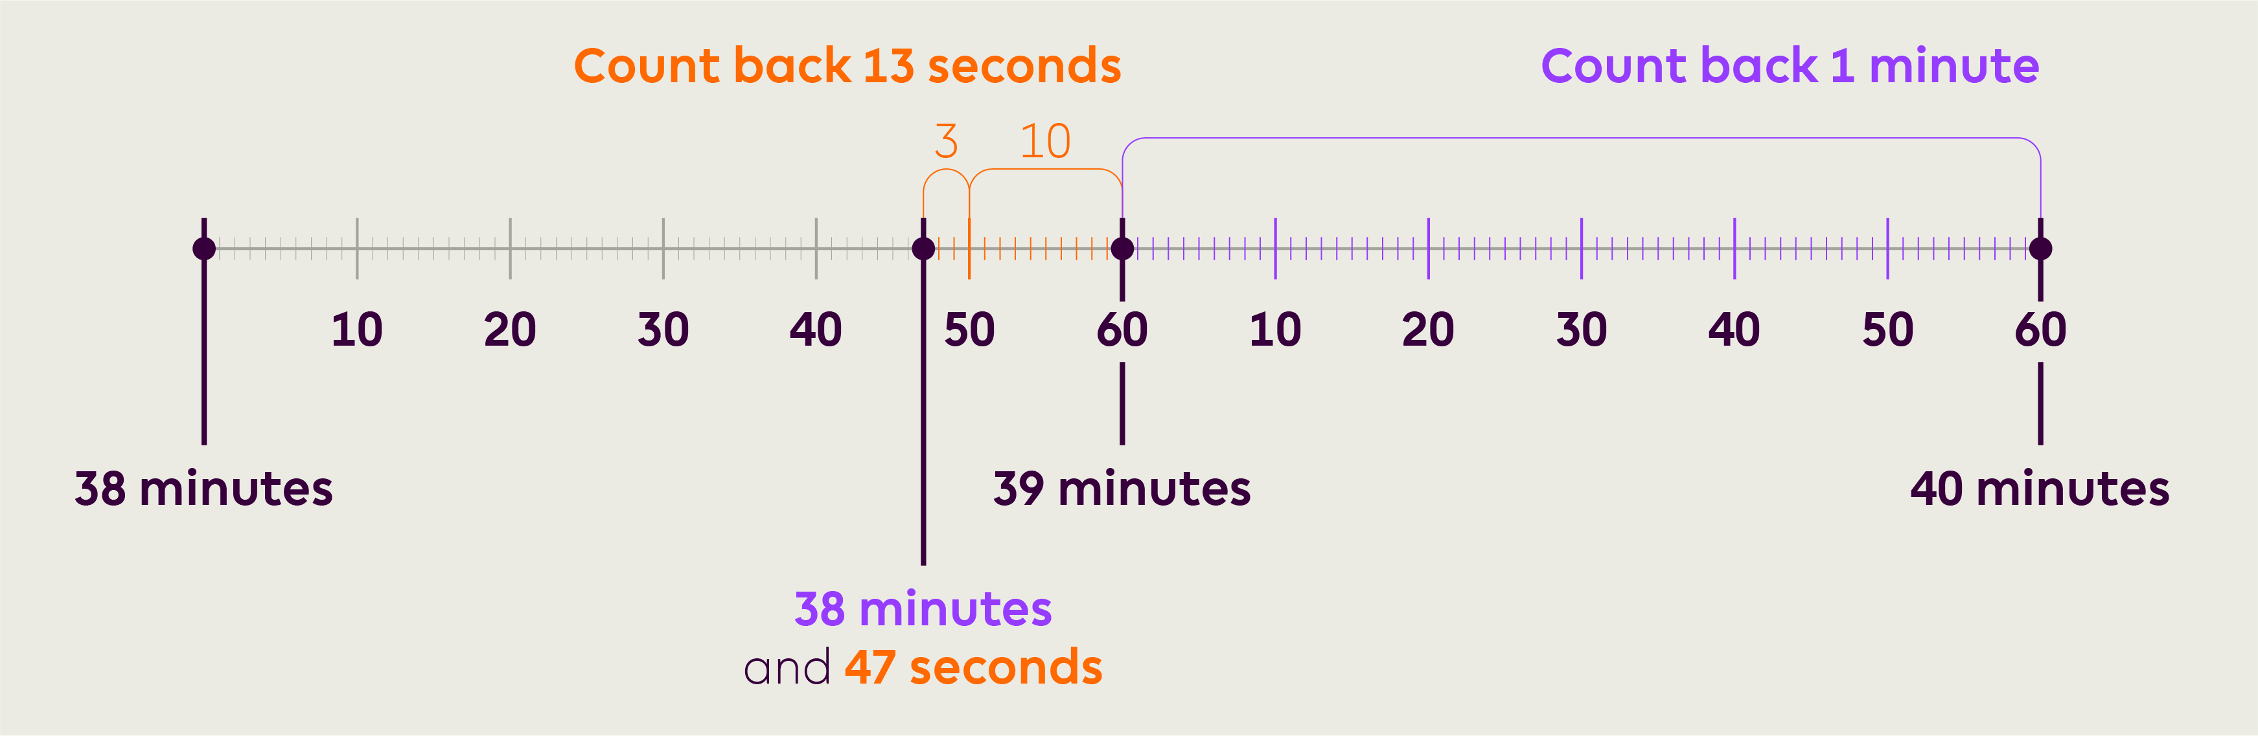
Using a number line for subtraction
You could also use a number line to count back:

Slide 17
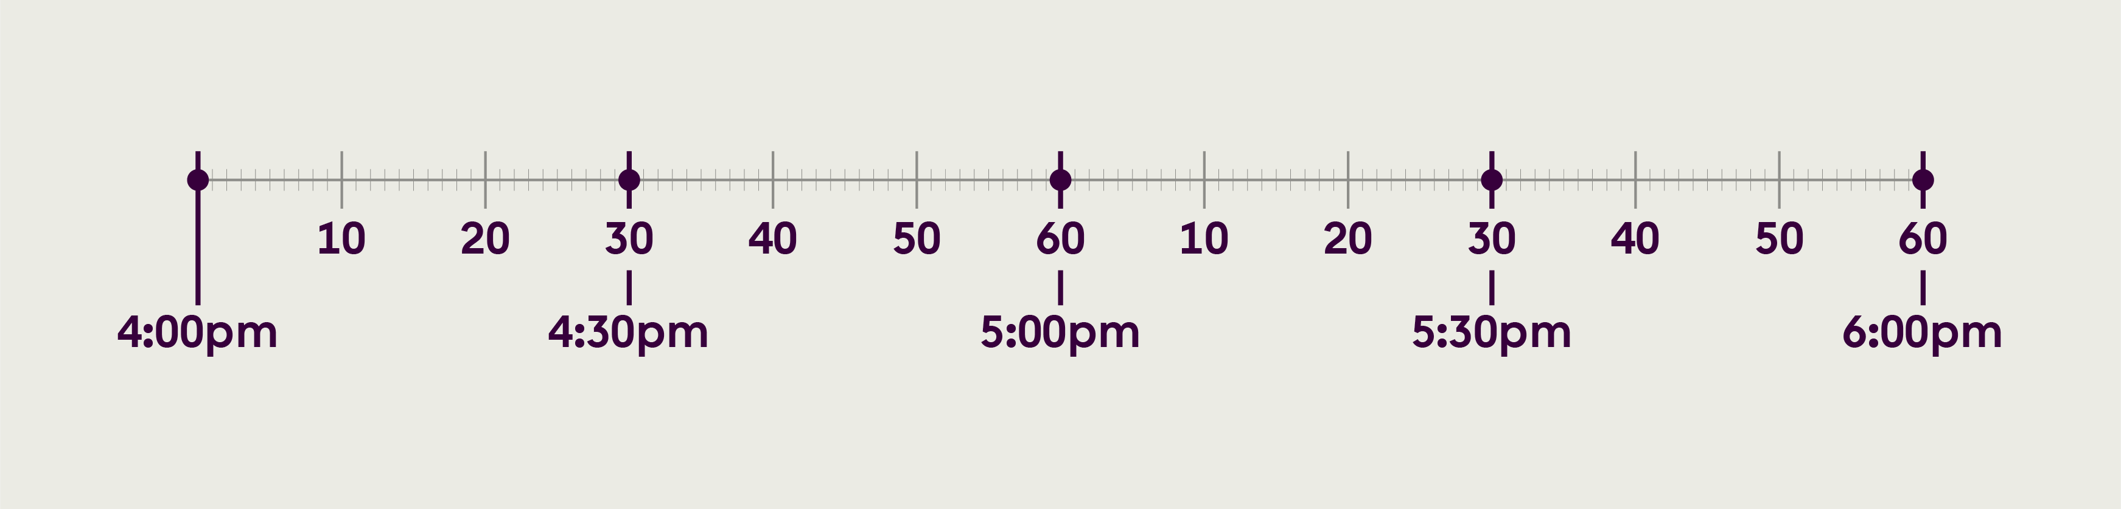
Calculations involving times of the day
Example of using a timeline to solve problems with different times of the day.
A match is 90 minutes. There is a 15 minute half time break and 7 minutes added time at the end. If it starts at 4:00pm, what time does it finish?

Slide 18
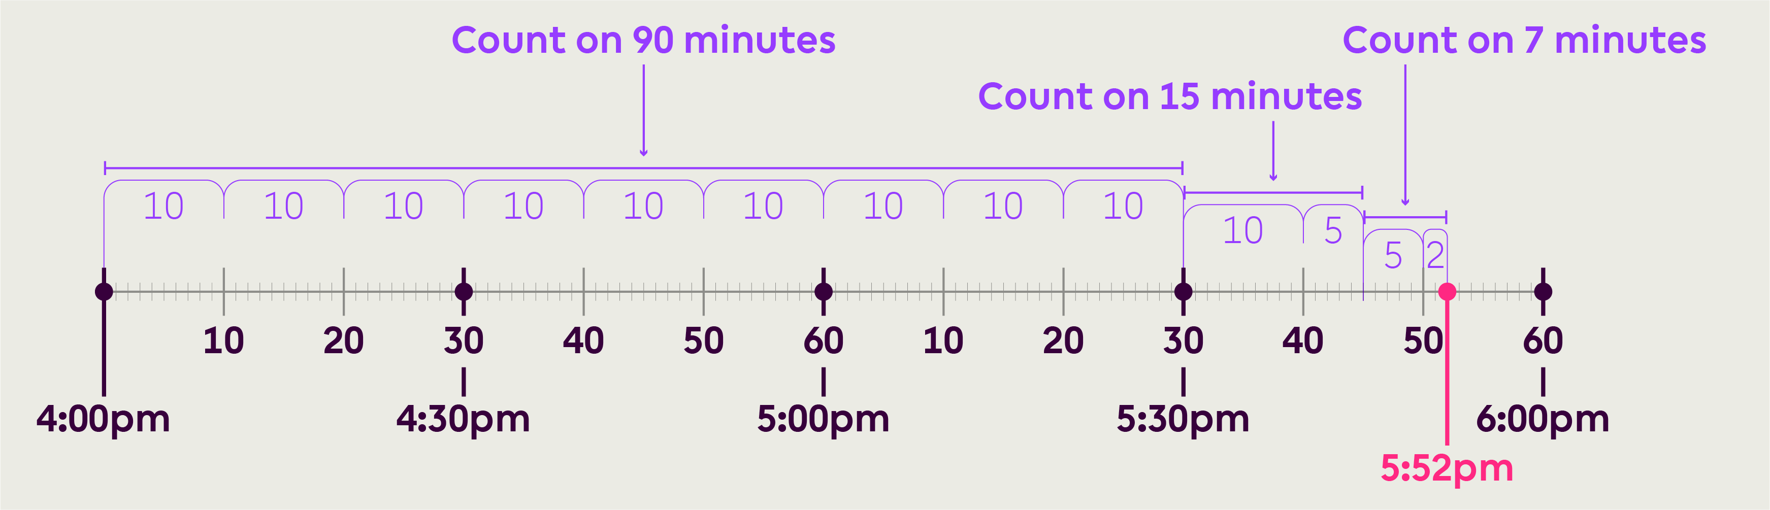
Calculations involving times of the day
Lets try adding this up on a timeline and try looking at it on the clock.

Slide 19
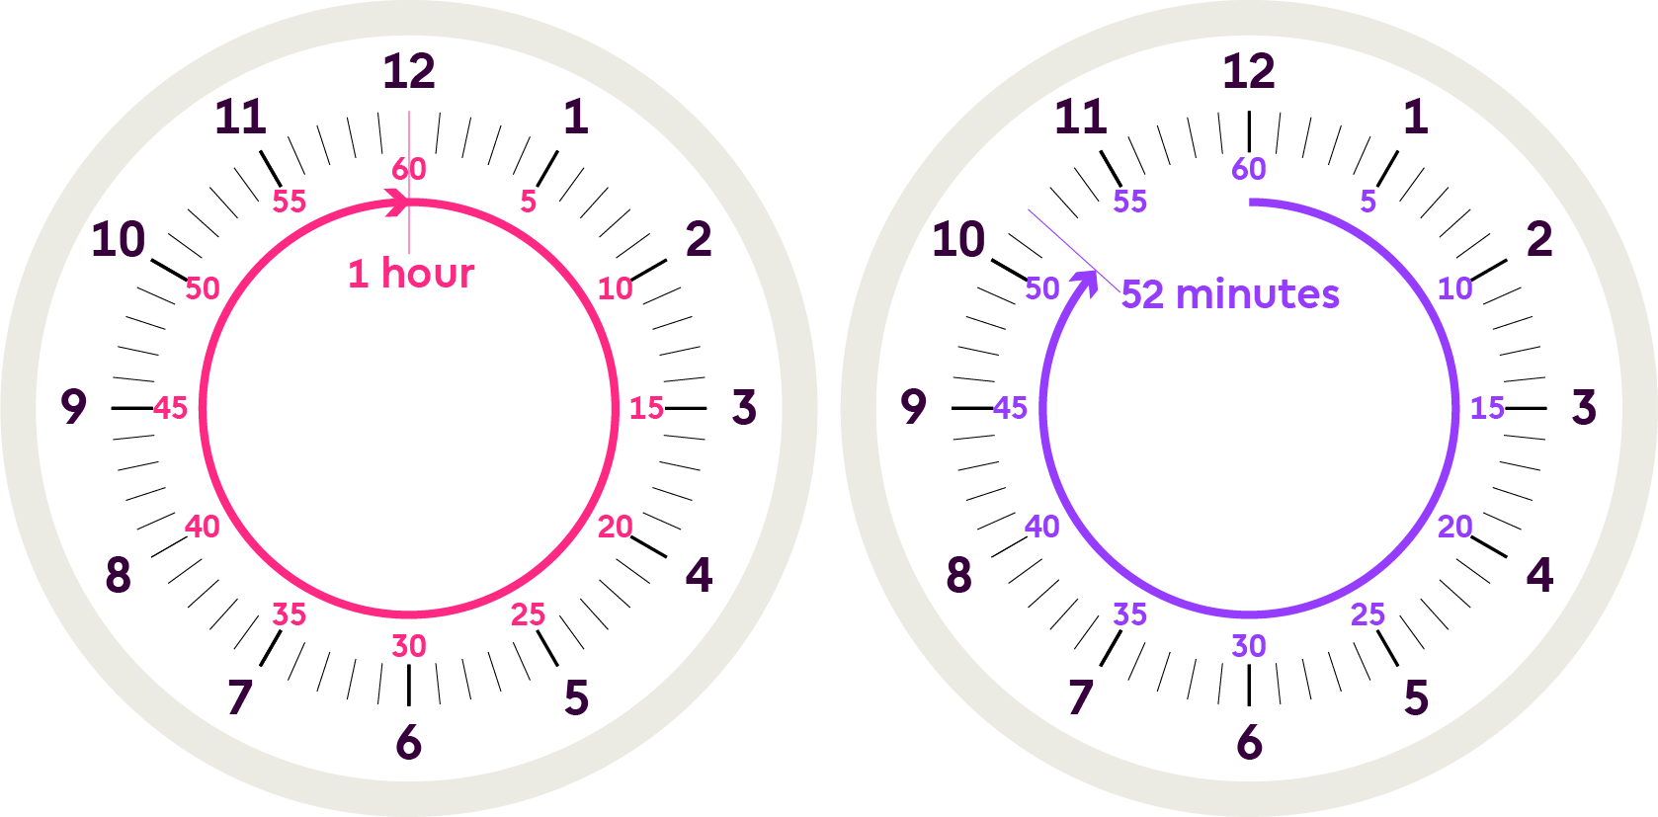
Calculations involving times of the day
Another way to complete this problem would be to add up all the times.
90 minutes + 15 minutes +7 minutes = 112 minutes
112 minutes = 1 hour (60 minutes) and 52 minutes
Count on from 4 pm: 1 hour takes you to 5:00pm
and 52 minutes would end at 5:52pm

